Slide 1
Friends
CS 201, Summer 2013

Slide 2
ADDITIONAL READING
Friends
  http://www.learncpp.com/cpp-tutorial/813-friend-functions-and-classes/
  http://www.cplusplus.com/doc/tutorial/inheritance/

Slide 3
Friends
In C++, classes can have friends.
Friends do not belong to the class itself, but can access members of a class.
Related to accessibility – Public, Protected, and Private.

Slide 4
Friends
A class can have another Class or just a Function as a friend.
Who are friends must be specified within the Class declaration.

Slide 5
Friends
Why friends?
  Maybe one class will work with another, and needs to access protected members.
  We don't want to add any public functions to access these because only one other class should have access!

Slide 6
Friend Functions
A Friend function can access private members of a class directly.
The Friend function can be part of another class, or just be a function independent of any objects.

Slide 7
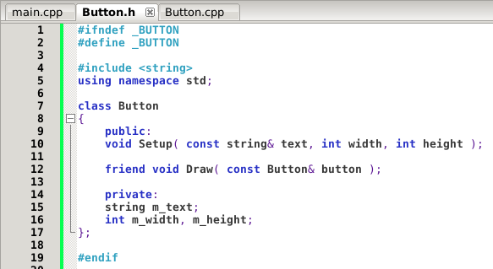
Friend Functions
Declaring a function
as a friend

Slide 8
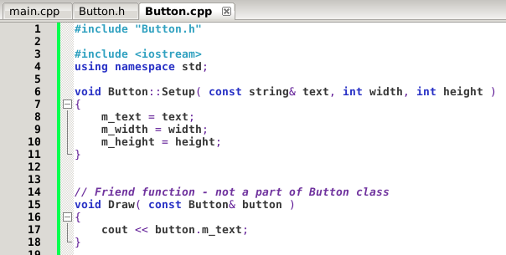
Friend Functions
Defining the Friend function inside of the Button.cpp file. Can access private member m_text!

Slide 9
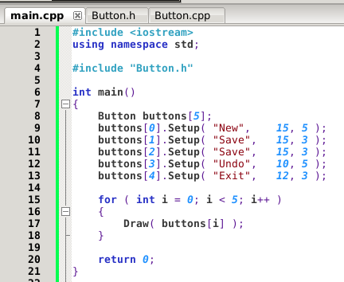
Friend Functions
Call the Friend function normally, it will have access to the argument's private members.

Slide 10
Other uses for Friends
Say we have a Fraction class. Normally when we write Fractions in math, we have something like:

Slide 11
Other uses for Friends
If we have a Fraction class in C++, and want to add a second Fraction, this could be a function that belongs to the Fraction class, but it looks awkward:
It looks a little better to have the fractions both be arguments:
Fraction.sum = fraction1.Add( fraction2 );
Fraction.sum = Add( fraction1, fraction2 );

Slide 12
Other uses for Friends
But then we need to add a bunch of functions just to add two fractions...
  Multiply Numerator and Denominator
  Set Numerator
  Set Denominator
  Get Numerator
  Get Denominator

Slide 13
Other uses for Friends
We could make Add(...) a Friend of the Fraction class, so we don't have to implement all these setter/getter functions that are only used by Add(...) and nowhere else (in this implementation, anyway).

Slide 14
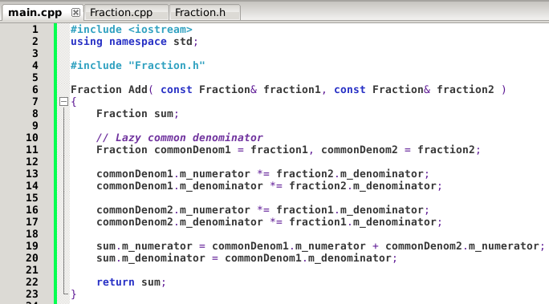
Other uses for Friends
Accessing private members of Fraction directly

Slide 15
Other uses for Friends
In a bit, we will take this one step further and use Function Overloading and Friend Functions to write our own implementations of common C++ symbols:
  +, -, *, /, <<, >>, and so on...
From
Fraction sum = Add( fraction1, fraction2 );
To
Fraction sum = fraction1 + fraction2;

Slide 16
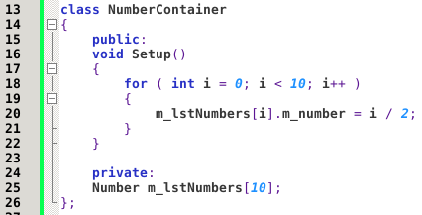
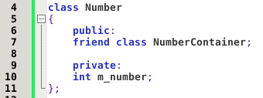
Friend Classes
Besides just functions, we can make Classes friends with each other.
  The Friend Class has access to the other's private members, but not vice versa.

Slide 17
Friend Classes
Note that:
  Friendships are not corresponded
    If class A is a friend of class B,
    class B is not automatically a friend of class A.
  Friendships are not transitive
    If class A is a friend of class B,
    and class B is a friend of class C,
    class A is not automatically a friend of class C.
(wikipedia.org)

Slide 18
Friend Classes
Note that:
  Friendships are not inherited
    A Child class doesn't inherit the friends of its Parent class.
  Access due to Friendship is inherited
    If Class “Email” is a friend of “Attachment” then Email can access Attachment's members, including the members inherited by its children, through the children.
(wikipedia.org)

Slide 19
References
Wikipedia.org
Friend class
https://en.wikipedia.org/wiki/Friend_class#Two_classes_accessing_private_data_to_each_other

